Slide 1
FoodFly
Sachin Deb | 1805020
Nafis Karim | 1805027
Mamun Munshi | 1805028

Slide 2
TABLE OF CONTENTS
01
02
03
04
05
06
07
08
Architecture
Choice
Flow of
Control
Module
Details
Motivation
Model
Details
View
Details
Controller
Details
API
Documentation

Slide 3
01
Architecture
Choice

Slide 4

Model View Controller (MVC)
3 Components
Model : Data
View : User Interface (UI)
Controller : Intermediary between Model and View

Slide 5
02
Motivation

Slide 6

MOTIVATION
WHY MVC
REASON
There are multiple architectures to choose from such as Microservice, Layered, Data-Centered Architecture
MVC promotes separation of models and views making the code more Modular, Maintainable, and Easily Testable

Slide 7
03
Modules
Overview

Slide 8
SYSTEM MODULES
1.User account
2.Business account
3.Delivery man account
4.Payment
5.Food order

Slide 9
04
Flow of Control

Slide 10

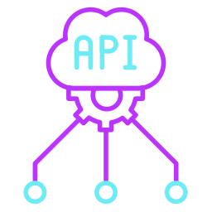


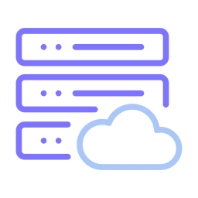
Flow of Control
View
Controller
Model
CRUD API Request
Fetch/Update Data
View Request
JSON Response
Server
Update View
React
Pages
Action Trigger
Store Action
Database
Notification Service
Send Notification
Send Data

Slide 11
05
MODEL
DETAILS

Slide 12
MODEL DETAILS
Database Server : MySQL
Object Relational Mapping (ORM) : Hibernate

Slide 13
06
VIEW
DETAILS

Slide 14
VIEW DETAILS
Framework : React
Principles To Be Maintained :
Single Responsibility Principle
Open-Closed Principle
Reusable Components

Slide 15
07
CONTROLLER
DETAILS

Slide 16
CONTROLLER DETAILS
Technology : SpringBoot
Deployment : AWS(Amazon Web Services)
CRUD API : SpringBoot (@RestController,@RequestMapping)

Slide 17
08
API
DOCUMENTATION
Documentation link

Slide 18
THANK YOU!

